Slide 1
Visual Studio 2022 + .NET 6
Adelaide Launch Event
Notes:
Hi, I’m David Gardiner, senior developer for SixPivot, Microsoft MVP and organizer of Adelaide .NET User Group…

Slide 2
Overview
Visual Studio 2022
C# 10
.NET 6
ASP.NET Core 6
EF Core 6
MAUI Preview

Slide 3
Visual Studio 2022
Demo

Slide 4
Visual Studio 2022
64-bit!

Slide 5
Visual Studio 2022
.NET Productivity
Introduce parameter refactoring can move a new parameter from the method implementation to its callers.
Track Value Source for data flow analysis
Option to underline variables that are re-assigned
Added search option in Generate Overrides dialog
Quick info for XML <code> tags now preserve whitespace and CDATA blocks
Find All References window will now group multi-target projects
Refactoring to remove repetitive types in Visual Basic
Go to Implementation will no longer navigate to members with abstract declarations that are also overridden.

Slide 6
Visual Studio 2022
.NET Productivity
Nullable reference types is now enabled by default for new .NET projects
C# 10.0 File-scoped namespace refactoring
Navigate to decompiled sources is now on by default
Refactoring to prefer null check over type check
XML comments will now automatically generate an <exception> tag when a method explicitly throws exceptions
Inheritance Margin is now enabled by default
Synchronize namespaces to match your folder structure from Solution Explorer
Configure background code analysis from Solution Explorer

Slide 7
C# 10.0
Demo

Slide 8
C# 10.0
Record structs
Improvements of structure types
Interpolated string handlers
global using directives
File-scoped namespace declaration
Extended property patterns
Allow const interpolated strings
Record types can seal ToString()
Allow both assignment and declaration in the same deconstruction
Allow AsyncMethodBuilder attribute on methods

Slide 9
C# 10.0
Lambda improvements
Caller argument expression
Extend the preprocessor line directive
Improved definite assignment
Update preprocessor symbols for .NET 6
Static abstract members in interfaces
Notes:
Lambda improvements - Allow lambdas with attributes, allow lambdas with explicit return type, infer a natural delegate type for lambdas and method groups
Caller argument expression - This would aid in debugging and diagnostic scenarios. It would allow methods to capture the expression passed to a method for diagnostic purposes.
Extend the preprocessor line directive - allow specifying full span mapping

Slide 10
.NET 6
ARM64
Crossgen2
Dynamic PGO
Codegen
W^X
Notes:
Crossgen2 – (PublishReadyToRun) - enables pre-compiling IL to native code as a publishing step. Pre-compilation is primarily beneficial for improving startup
W^X - It is a requirement on Apple Silicon machines and a useful security measure on other operating systems. This feature has an abnormal name. It should be read as “write exclusive execute”. That means that a memory page can be marked for read/write or read/execute but never any combination that includes write and execute. Write/execute pages are subject to being exploited with buffer overrun attacks, for example. Opt-in due to perf hit on non-Apple silicon
Dynamic PGO - is integrated with RyuJIT. Where static PGO requires a separate training activity and using special tools, dynamic PGO is automatic and uses the running application to collect relevant data. Where static PGO data is persisted, dynamic PGO data is lost after every application run. Opt-in

Slide 11
.NET 6
Demo

Slide 12
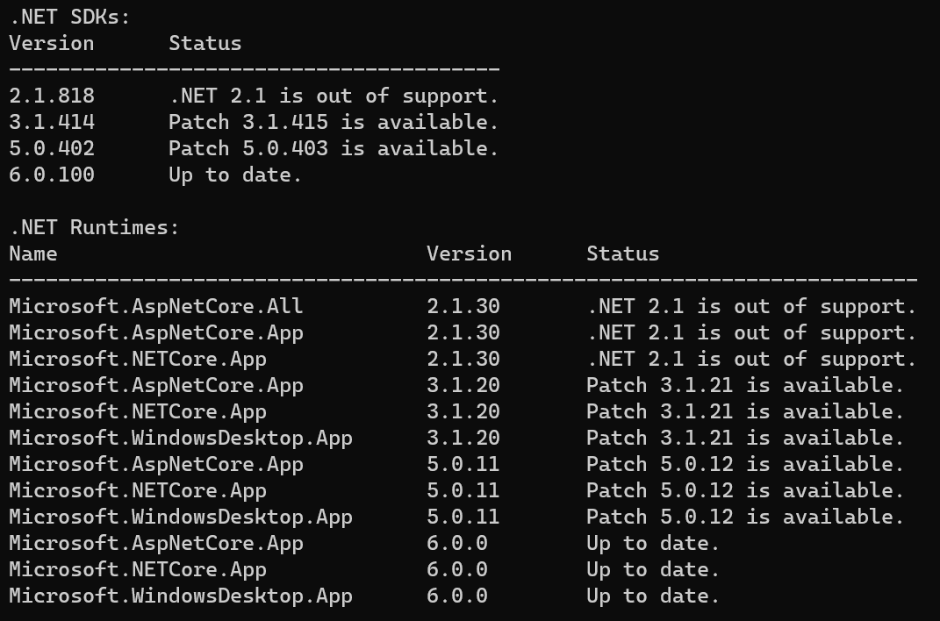
.NET 6 - CLI
Response files are now supported
Directives
Optional workloads
dotnet sdk check

Slide 13
.NET 6 - Diagnostics
EventPipe for Mono and Improved EventPipe Performance
(EventPipe/DiagnosticsServer) – MonoVM

Slide 14
.NET 6 - Tools
Hot Reload with the Visual Studio debugger and dotnet CLI
IL Trimming
Single-file publishing
NuGet Package Validation
more Roslyn Analyzers
Enable custom guards for Platform Compatibility Analyzer
Objective-C interoperability support
C# project templates modernized
Notes:
Single-file publishing – better analyzers to warn about Assembly.Location, Compression, uses Crossgen2

Slide 15
.NET 6 - Libraries
New math APIs
Improved support for Windows ACLs
Portable thread pool
System.Text.Json – ReferenceHandler.IgnoreCycles
PriorityQueue
Better parsing of standard numeric formats
SignalR – Nullable annotations
Faster handling of structs as Dictionary values
Faster interface checking and casting

Slide 16
.NET 6 - Libraries
System.Text.Json support for IAsyncEnumerable
System.Text.Json Writable DOM Feature
Microsoft.Extensions.Logging compile-time source generator
System.Linq enhancements
Significantly improved FileStream performance on Windows
Enhanced Date, Time and Time Zone support
WinForms – default font and more designers

Slide 17
.NET 6 - Libraries
Dropping support for older frameworks
Microsoft.Extensions
JsonSerializer Source generation
WebSocket Compression
Socks proxy support
Support for OpenTelemetry Metrics
Vector<T> now supports nint and nuint

Slide 18
.NET 6 - Libraries
Support for OpenSSL 3
Add support ChaCha20/Poly1305 cryptography algorithm
TLS support for System.DirectoryServices.Protocols
Improved sync-over-async performance
Reflection APIs for nullability information
ZipFile Respects Unix File Permissions
NativeMemory APIs

Slide 19
.NET 6 - Libraries
System.Text.Json serialization notifications
System.Text.Json serialization property ordering
“write raw” JSON with System.Text.Json.Utf8JsonWriter
Synchronous stream overloads on JsonSerializer
System.Text.Json.Nodes.JsonNode support for dynamic is removed
System.Diagnostics Propagators
Simplified call patterns for cryptographic operations
Full Case Mapping Support in Globalization Invariant Mode

Slide 20
.NET 6 - Runtime
Support for Apple Silicon (M1 Arm64), .NET Rosetta 2 Emulation
Improving single file apps
Single-file signing on macOS
Crossgen2
Dynamic PGO
Arm64 performance
Hardware-accelerating structs

Slide 21
.NET 6 - Runtime
Framework Assemblies are compiled with Crossgen2
Profile guided optimization
JIT improvements
Faster handling of structs as Dictionary values
Faster interface checking and casting
W^X memory policy

Slide 22
ASP.NET Core 6
Demo

Slide 23
ASP.NET Core 6
Support for IAsyncDisposable in MVC
DynamicComponent
Input ElementReference exposed on relevant components
Nullable reference type annotations

Slide 24
ASP.NET Core 6
Razor compiler updated to use source generators
Support for custom event arguments in Blazor
CSS isolation for MVC Views and Razor Pages
Infer component generic types from ancestor components
Preserve prerendered state in Blazor apps
SignalR – Nullable annotations
Smaller SignalR, Blazor Server, and MessagePack scripts

Slide 25
ASP.NET Core 6
Enable Redis profiling sessions
HTTP/3 endpoint TLS configuration
Initial .NET Hot Reload support
Razor compiler no longer produces a separate Views assembly
Shadow-copying in IIS
Vcpkg port for SignalR C++ client
Reduced memory footprint for idle TLS connections
Remove slabs from the SlabMemoryPool
BlazorWebView controls for WPF & Windows Forms

Slide 26
ASP.NET Core 6
Introducing minimal APIs
Async streaming
HTTP logging middleware
Use Kestrel for the default launch profile in new projects
IConnectionSocketFeature
Improved single-page app (SPA) templates
Generic type constraints in Razor components
Blazor error boundaries
Blazor WebAssembly ahead-of-time (AOT) compilation
.NET MAUI Blazor apps
Other performance improvements

Slide 27
ASP.NET Core 6
.NET Hot Reload updates for dotnet watch
ASP.NET Core SPA templates updated to Angular 11 and React 17
Use Razor syntax in SVG foreignObject elements
Specify null for Action and RenderFragment component parameters
Reduced Blazor WebAssembly download size with runtime relinking
Configurable buffer threshold before writing to disk in Json.NET output formatter
Subcategories for better filtering of Kestrel logs
Faster get and set for HTTP headers
Configurable unconsumed incoming buffer size for IIS

Slide 28
ASP.NET Core 6
Improved Blazor accessibility
Required Blazor component parameters
Efficient byte array transfers for JavaScript interop
Optional parameters for view component tag helpers
Angular template updated to Angular 12
OpenAPI support for minimal APIs
Inject services into minimal APIs without [FromServices] attribute

Slide 29
ASP.NET Core 6
Configure the accept socket for Kestrel
IHttpActivityFeature
Long running activity tag for SignalR connections
WebSocket compression
SignalR WebSockets TestServer support
New OnCheckSlidingExpiration event for controlling cookie renewal
ClientCertificateMode.DelayCertificate

Slide 30
ASP.NET Core 6
Added IResult implementations for producing common HTTP responses
Minimal host and template improvements
Supply Blazor component parameters from the query string
Replace the current URI in the browser history from Blazor
New DynamicComponent.Instance property
Blazor streaming interop from JavaScript to .NET
Large file upload & faster file uploads with Blazor

Slide 31
ASP.NET Core 6
Modify HTML <head> content from Blazor components
Support for the multiple attribute on <select> elements in Blazor
Support for HTTP/3 in Kestrel
Allow control over Activity creation
Support for non-ASCII characters in Kestrel response headers
Add W3CLogger
Add authentication expiration option to SignalR

Slide 32
ASP.NET Core 6
Render Blazor components from JavaScript
Blazor custom elements
Manipulate the query string from Blazor
.NET to JavaScript streaming
PageX and PageY in MouseEventArgs
Blazor templates updated to set page titles
Disabled long-polling transport for Blazor Server
Collocate JavaScript files with pages, views, and components

Slide 33
ASP.NET Core 6
JavaScript initializers
Customize Blazor WebAssembly packaging
Support for Latin1 encoded request headers in HttpSysServer
Emit KestrelServerOptions via EventSource event
Add timestamps and PID to ASP.NET Core Module logs
New DiagnosticSource event for rejected HTTP requests
Create a ConnectionContext from an Accept Socket

Slide 34
EF Core 6
Demo

Slide 35
EF Core 6
UnicodeAttribute
PrecisionAttribute
EntityTypeConfigurationAttribute
Translate ToString on SQLite
EF.Functions.Random
Support for SQL Server sparse columns
In-memory database: validate required properties are not null
Improved SQL Server translation for IsNullOrWhitespace
Database comments are scaffolded to code comments

Slide 36
EF Core 6
Microsoft.Data.Sqlite
Savepoints API
Command timeout in the connection string
Preserve synchronization context in SaveChangesAsync
Translate String.Concat with multiple arguments
Smoother integration with System.Linq.Async
More flexible free-text search

Slide 37
EF Core 6
The runtime perf push
Pooling and recycling, DbContext and beyond
Logging suppression
Opting out of thread-safety checks

Slide 38
EF Core 6
Compiled models
Support for 64-bit identity seed values
Support for new BCL DateOnly and TimeOnly structs for SQLite
Uniquify and validate check constraint names
Pre-convention model configuration
Migration bundles

Slide 39
MAUI Preview
Demo

Slide 40
MAUI Preview
Windows Desktop Now Supported
Updates to Controls and Layouts
BlazorWebView
Splash Screen
Raw Assets
Visual Studio Productivity
Animations
UI Components
Single Project Templates Updates
Workload Installation

Slide 41
MAUI Preview
Workload Installation
Gestures
Clipping
Native Alerts
Single Project and Windows
Accessibility Changes and Improvements
Font Scaling
Borders, Corners, and Shadows – Oh my!
Quick Android Startup
Ecosystem Controls (DevExpress, Syncfusion, Telerik)

Slide 42
MAUI Preview
Use Visual Studio 2022 Preview
https://docs.microsoft.com/en-au/dotnet/maui/get-started/installation
https://github.com/dotnet/maui/wiki/Roadmap

Slide 43
Summary
My Blog
https://david.gardiner.net.au

